Slide 1
Year 7 Graduation 2021-2022
Music by jorikbasov-Pixabay

Slide 2
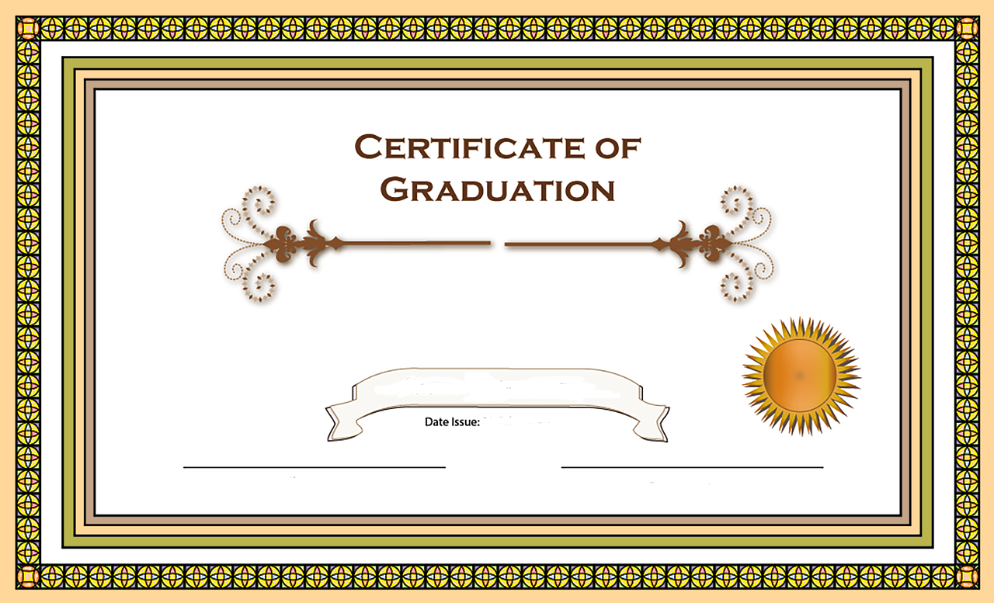
Graduation 2021-2022
161 students in the year group met the criteria to receive their Graduation certificate.
40 + Achievement Points
from 15 Nov ‘21 to 10 Jan ‘22
No more than 10 Behaviour Points from 15 Nov ‘21 to 10 Jan ‘22

Slide 3
Ambition Award Nominated by Subject Teachers
7A/7MS Cara Moulder
Cara is an extremely polite, hard-working pupil. She completes all work with enthusiasm and to the best of her ability. She is a delight to teach!
French
Ms Scantlebury
Cara is extremely polite and friendly. She always puts her all into her work. And, outside of the classroom, will always make an effort to say hello etc.
English, Mrs Jones

Slide 4
Ambition Award Nominated by Subject Teachers
7JWC/7D Sam Lee
Sam is a passionate, enthusiastic historian, developing a wide subject knowledge in his spare time. He is keen to share ideas and shown great commitment to History club.
History, Miss Williams
Sam is always keen to offer his (great) ideas! He is very polite, and always engaged and focused.
English, Miss Walker

Slide 5
Ambition Award Nominated by Subject Teachers
7JAD/7F Kieran Taylor
Kieran is polite and friendly at all times and has been producing some witty and imaginative theatre.
Drama, Miss Toms
Kieran is always enthusiastic and works diligently in lessons. He also has a good subject knowledge base and always adds interesting points in lessons.
Geography, Mrs Marshallsay/Mrs Trotman

Slide 6
Ambition Award Nominated by Subject Teachers
7RLJ/7L Ronnie Revers
Ronnie is always very inquisitive and engaged, a leader in class discussions.
History, Miss Williams
Ronnie has shown great independence in Mr Rees' absence. All work completed and handed in. Excellent assessment results and has shown maturity when improving his own learning and performance by completing all DIRT tasks set.
Geography, Mrs Trotman
Ronnie always engages with RS. He is always polite, always willing to lead the class discussion. His work demonstrates thorough understanding of the topic and he completes all tasks to the best standard! Da iawn!
RS, Miss Jefferies

Slide 7
Ambition Award Nominated by Subject Teachers
7N/7MJD Isabelle Barnett
Isabelle is always positive, offers answers and hardworking during lessons.
English, Mr Thomas
Isabelle is such a friendly, happy student to have in the class; she brightens my day. She works so hard to keep a beautiful sketchbook, every piece of work is thoroughly completed to the best of her ability both in class and at home.
Art, Mrs Allen-Bevan

Slide 8
Readiness Award Nominated by Form Tutors
7JWC
Paul-Antoine Benlian
Mr Crocker
Paul enters form every day with a huge smile on his face and has been very friendly and enthusiastic since the day he began year 7. Paul has also thrown himself in to several extra curricular activities offered by the school including all of the PE clubs, as well as music club and piano lessons. He is always happy to help his peers and has been a real pleasure in 7JWC.

Slide 9
Readiness Award Nominated by Form Tutors
7JAD
Pau Caffery
Mrs David
Pau is always polite, conscientious and works to the best of his ability. He is kind and considerate to staff and his peers. He is a lovely pupil.

Slide 10
Readiness Award Nominated by Form Tutors
7MJD
Lexi Carbis
Mrs Davis
Lexi is always engaged and willing. She is confident in herself and ready for the day - every day.

Slide 11
Readiness Award Nominated by Form Tutors
7RLJ
Sophie Grafton-Driscoll
Miss Jefferies
Sophie is always polite, engaged and willing to participate in class discussion and work. She has excellent attendance and is always ready to learn. She is confident in her ability, and always willing to help others around her. She is a pleasure to teach!

Slide 12
Readiness Award Nominated by Form Tutors
7RJN
Zach Waterhouse
Mr Nunes
From the moment I walk into form, Zach is always the first pupil to greet me with his enthusiastic approach. This has occurred every form time. He is always willing to participate in form time activities and is on hand to help at anytime.

Slide 13
Readiness Award Nominated by Form Tutors
7MS
Sydney Monaghan
Ms Scantlebury
Sydney is always enthusiastic and willing to engage in form activities. She is our form rep for which her mature and organised approach is ideal.

Slide 14
Transition Award
Elliot Thomas - Dysgu
Mrs Ballett
Since day one, Elliot he has blended in well with both Year 7 and Year 8 students. He has also managed to maintain his friendships with Year 7’s in other classes. Elliot puts a lot of effort into all his lessons and is always keen to help out with jobs around the classroom.
Highly Commended
Lloyd Turrell
Lloyd is always ready to learn and help others
Mrs Ballett

Slide 15
Bilingualism Award
This was based on Achievement Points for use of Welsh.
3 students received these awards.

Slide 16
Llongyfarchiadau
pawb!

