Slide 1
Religious Studies
Year 8 Cohort visit 24th and 25th June 2015
Consent letters to Mrs W by:
Thursday, 18th June

Slide 2
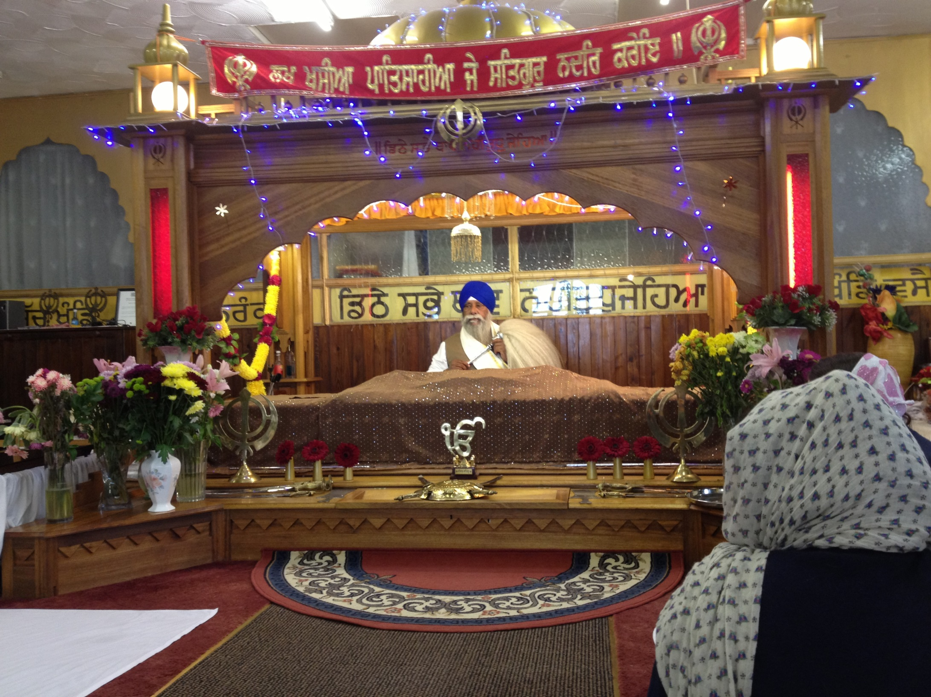
Sikh Gurdwara
Riverside

Slide 3
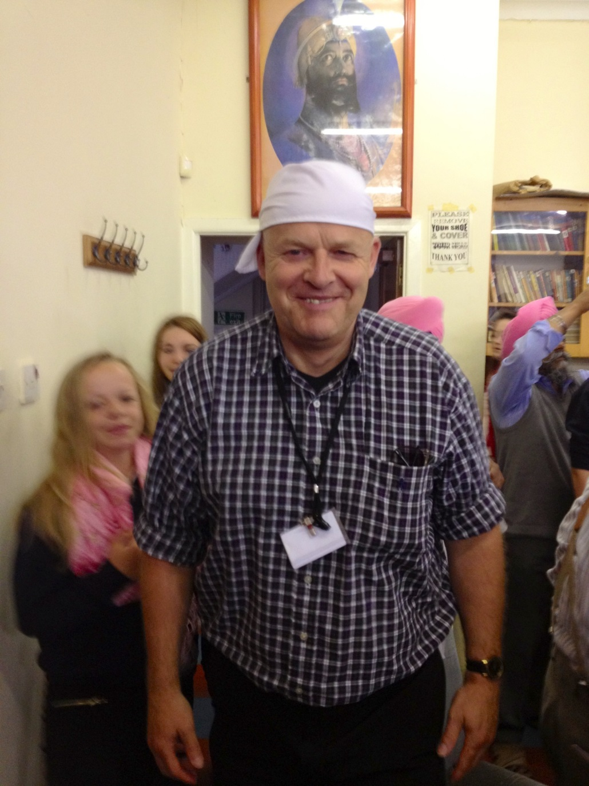
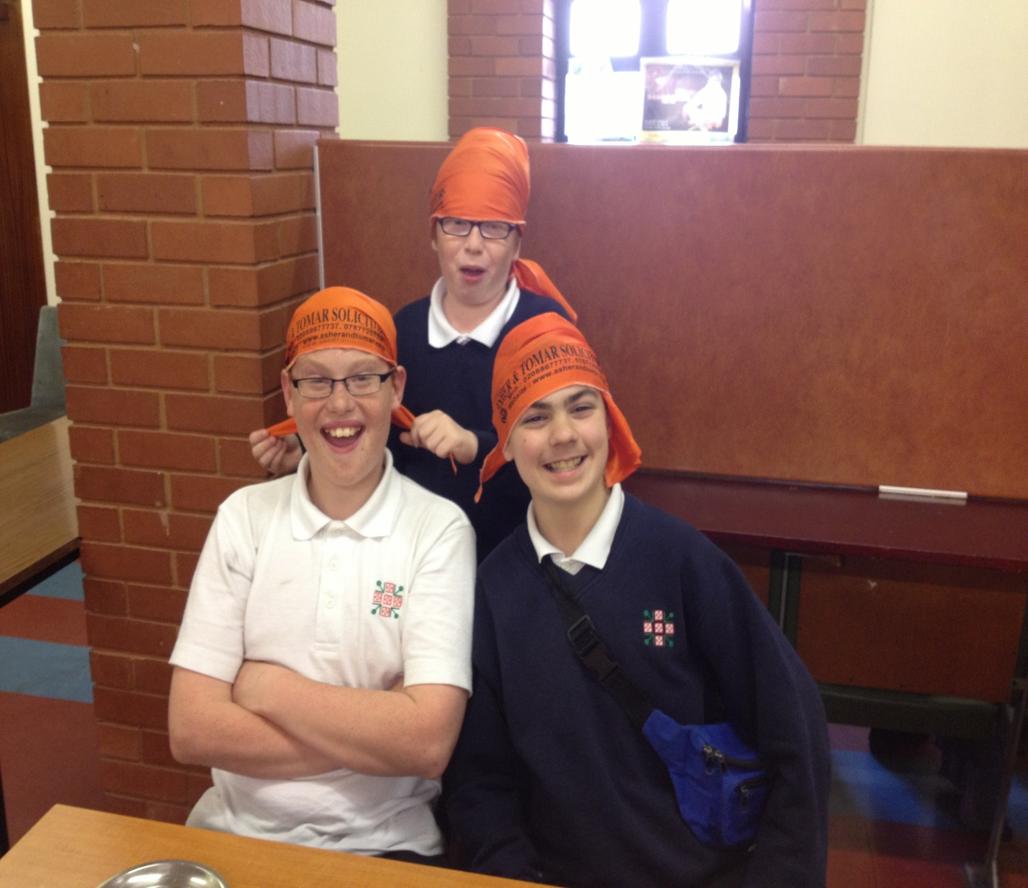
Sikh Gurdwara
Riverside

Slide 4
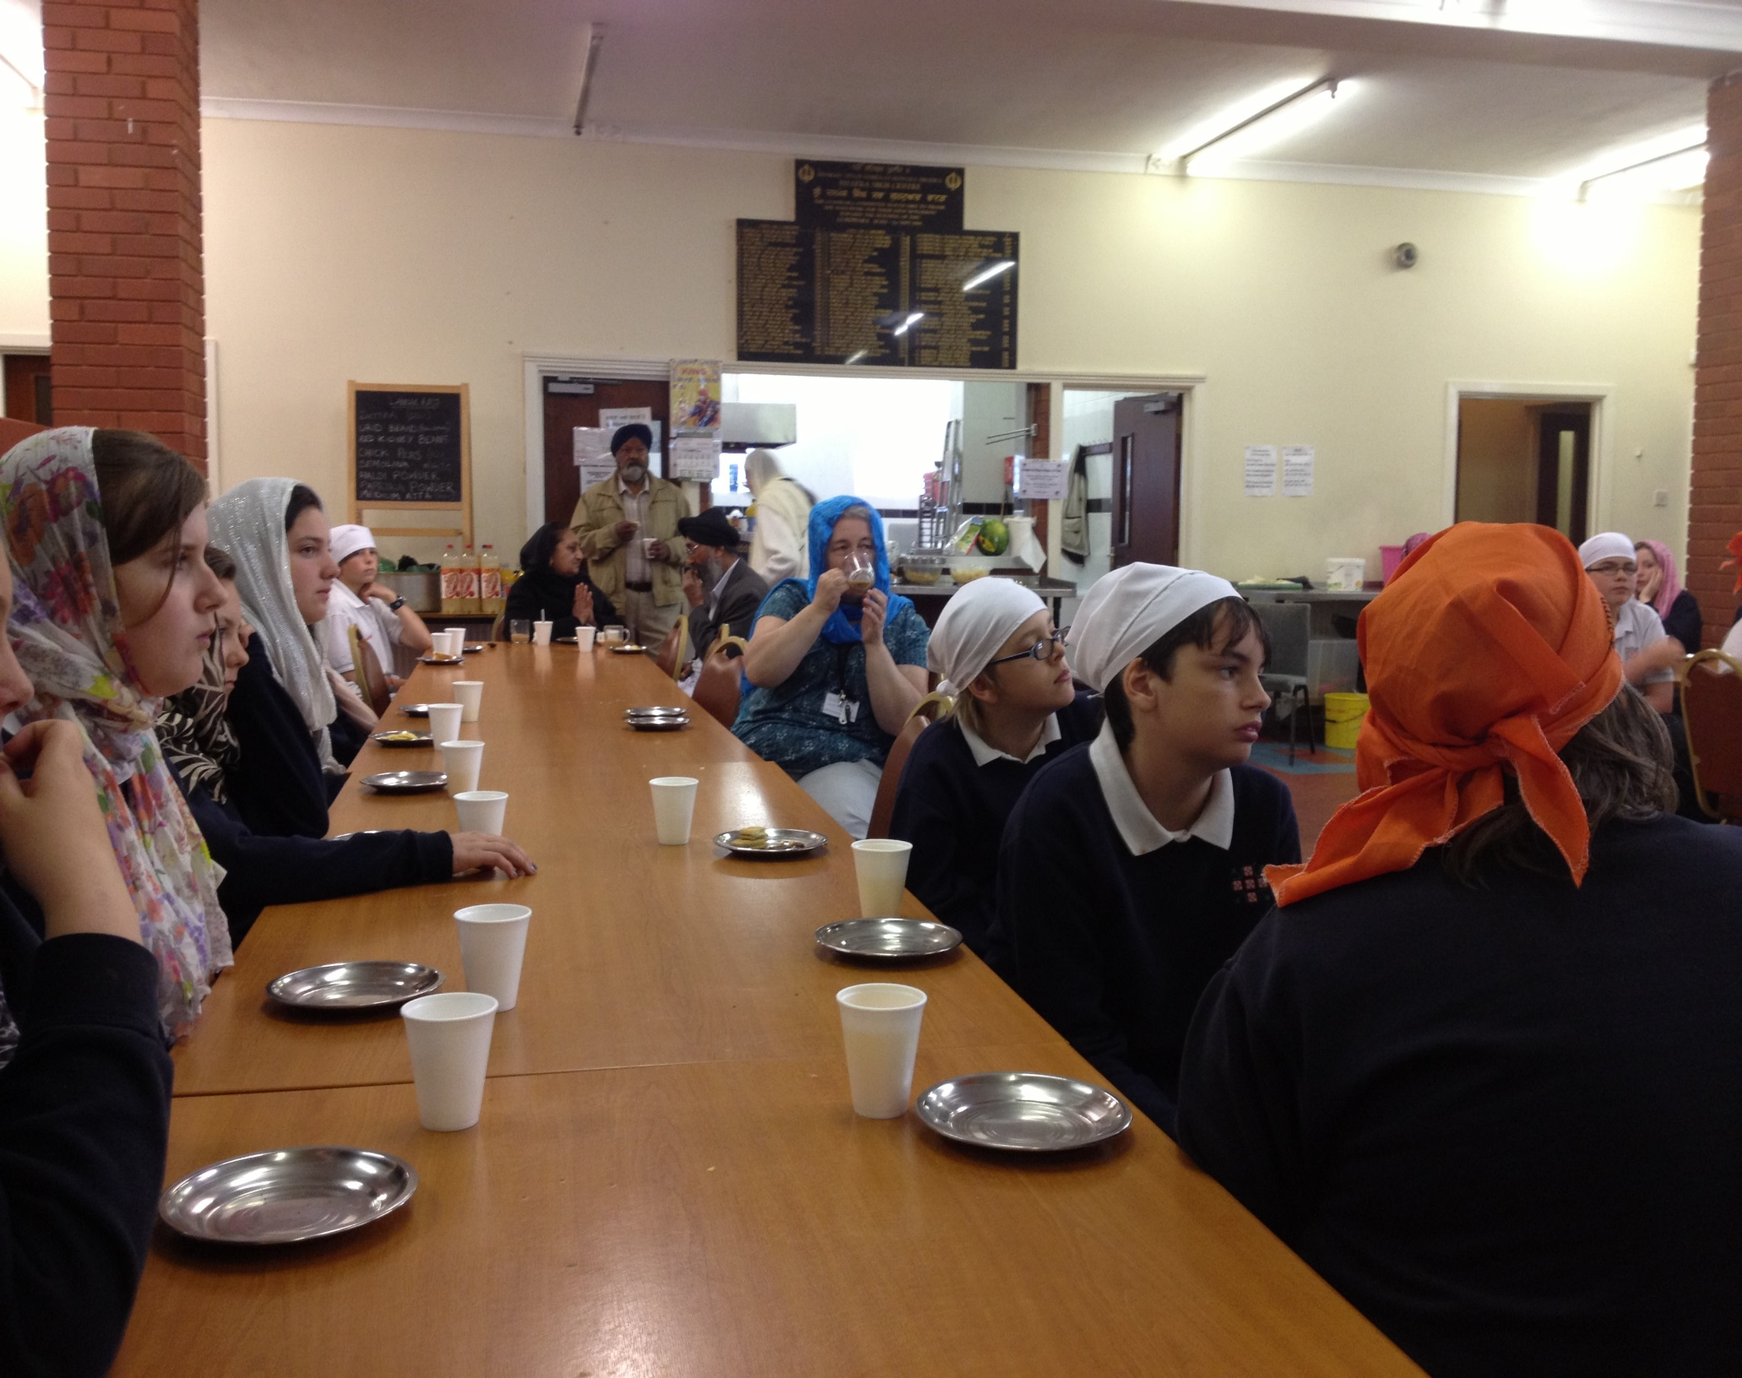
Sikh Gurdwara
Riverside

Slide 5
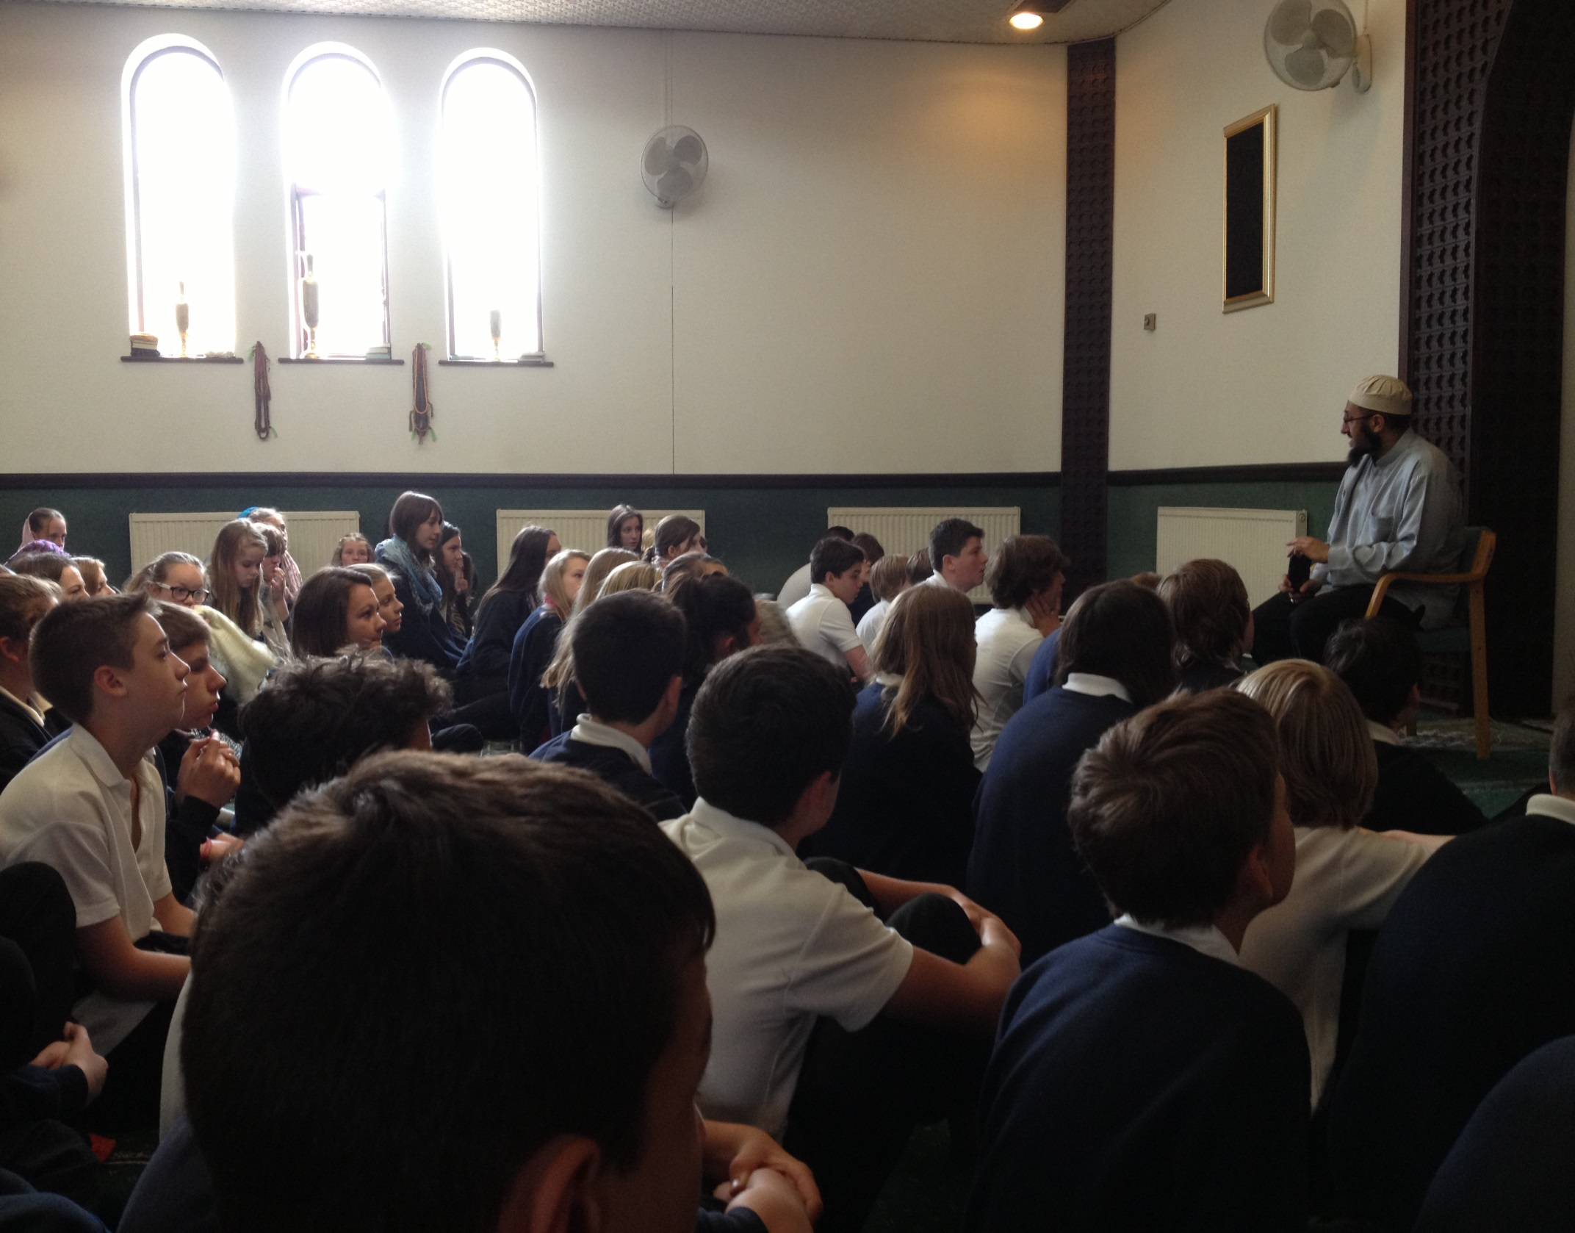
Alice St
Mosque

Slide 6
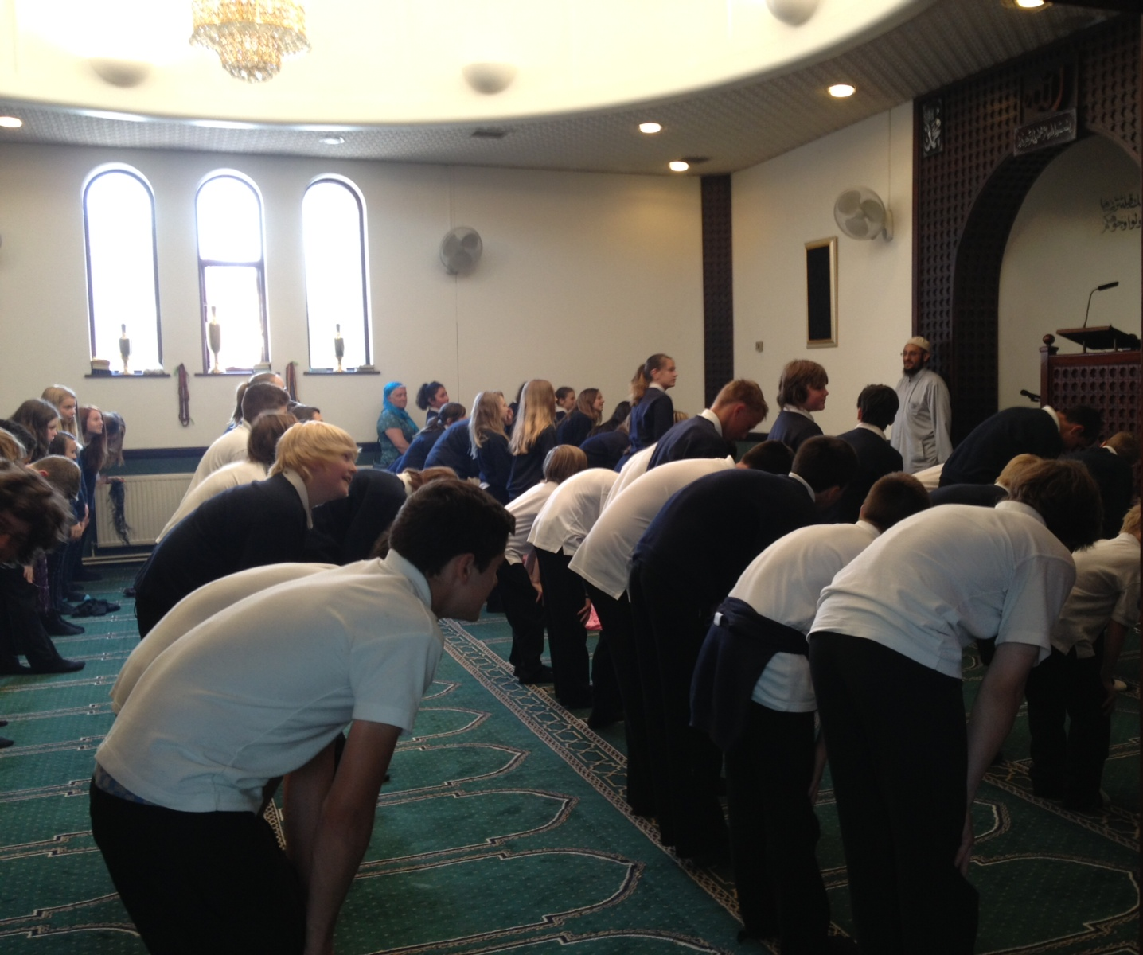
Alice St
Mosque

Slide 7
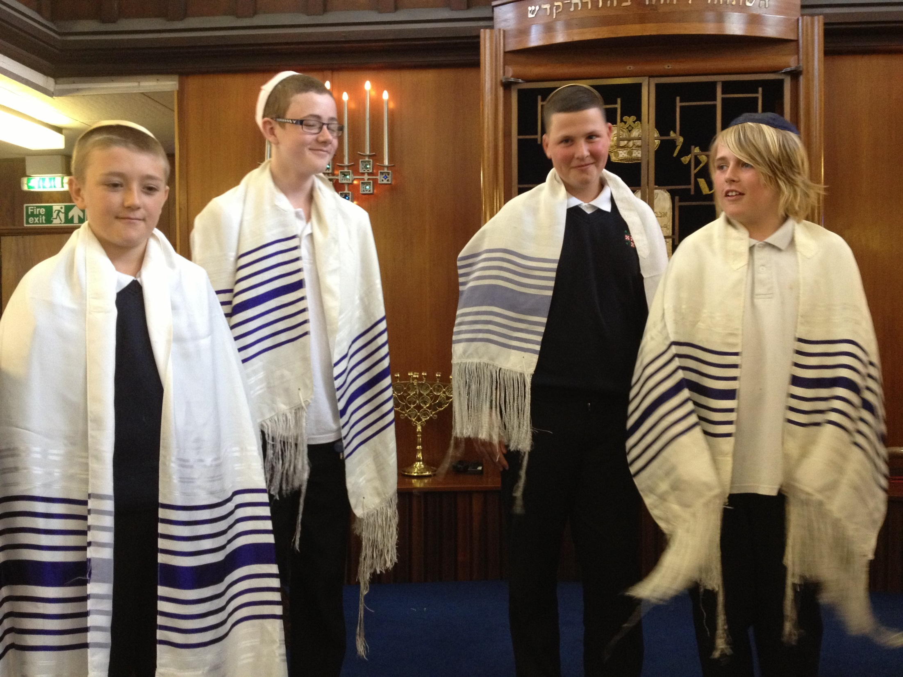
Reformed Synagogue

Slide 8
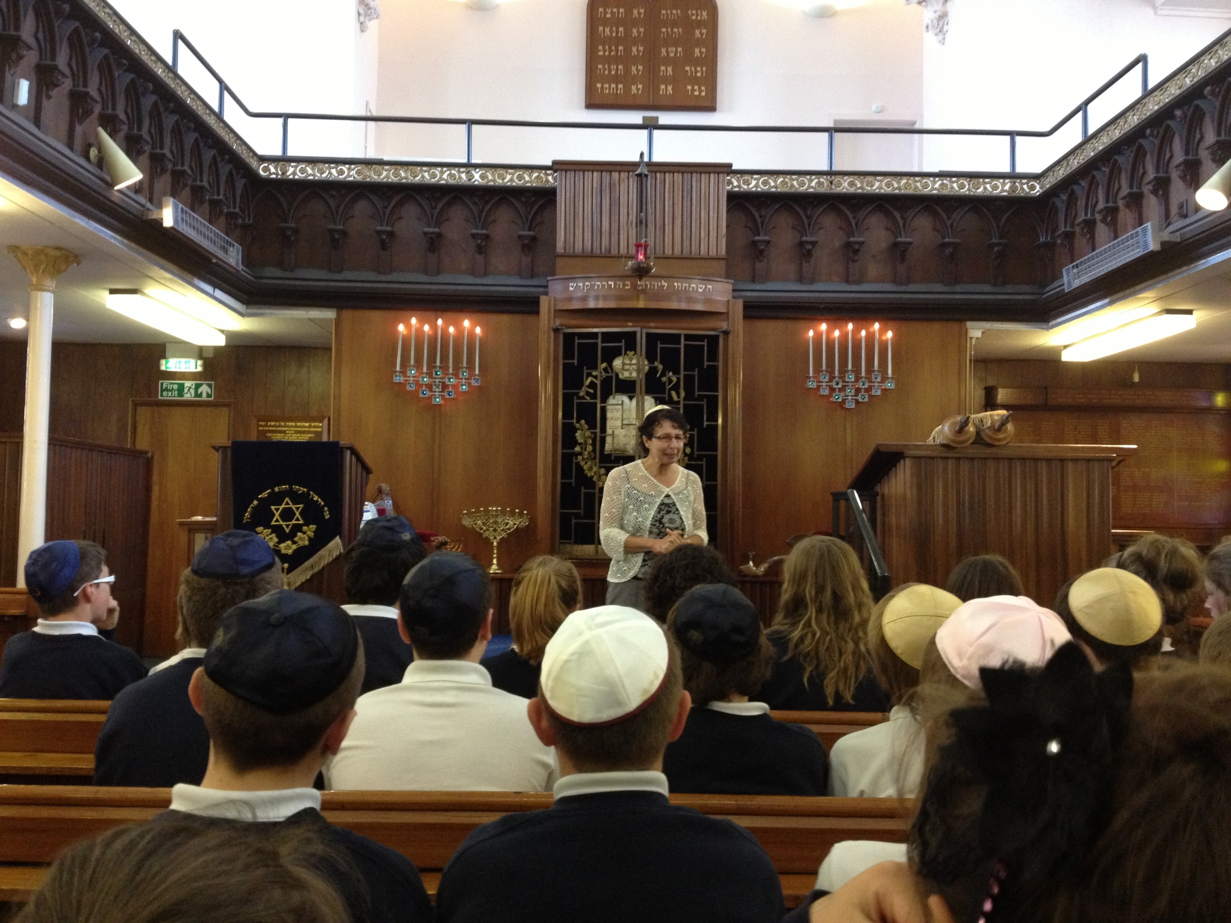
Moira Terrace Reformed Synagogue

